Slide 1
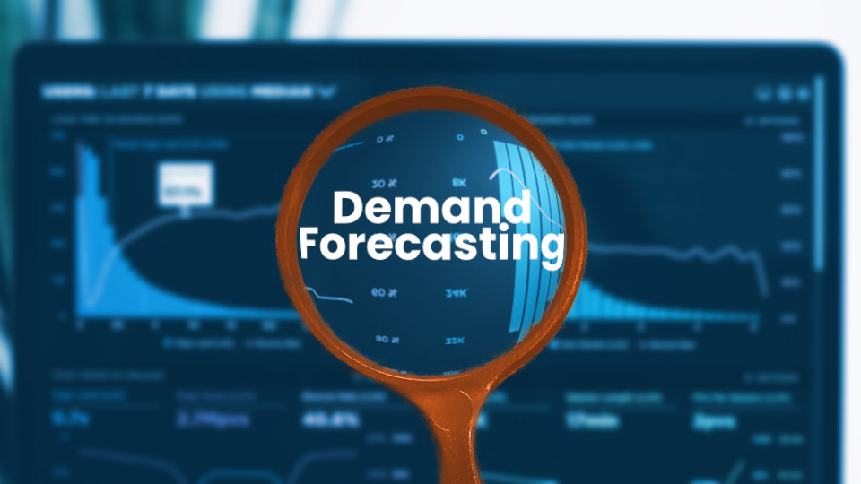
Sales-Demand Forecast for Shoe Distributor

Slide 2

Introduction
Inventory levels are critical to a business
Insufficient inventory results in lost sales
Too much inventory is a waste of resources
Proper demand forecasting is needed to insure good inventory levels

Slide 3

Methodology
Utilize historic sales data to predict customers’ demand for next two quarter
Time Series forecasting using
Arima
Sarimax
FBProphet
XGBoost
Ensemble methods

Slide 4
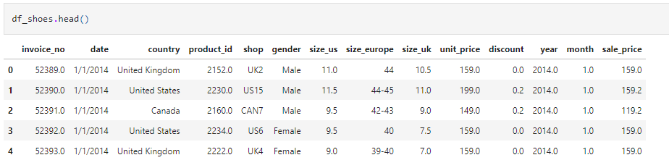
Data
Retrieved from towardsdatascience.com from an AWS S3 Bucket
Has Sales over a 3-year period
Has 14 features and over 14,000 recorded sales

Slide 5
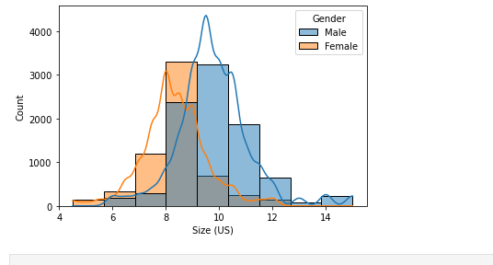
Exploratory Data Analysis
Inventory Purchase Ratio
For men, every 3 pair of size 10 should be accompanied by
2 pair of size 11 or 9 and
1 pair of size 12 or 8

Slide 6
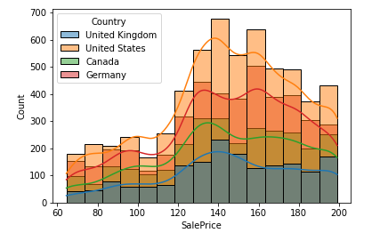
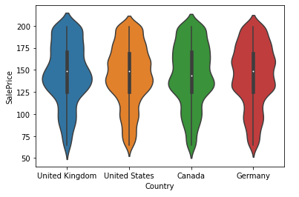
Sales
Sales follow a modal or bi-modal distribution
Sales Prices are similar across countries

Slide 7
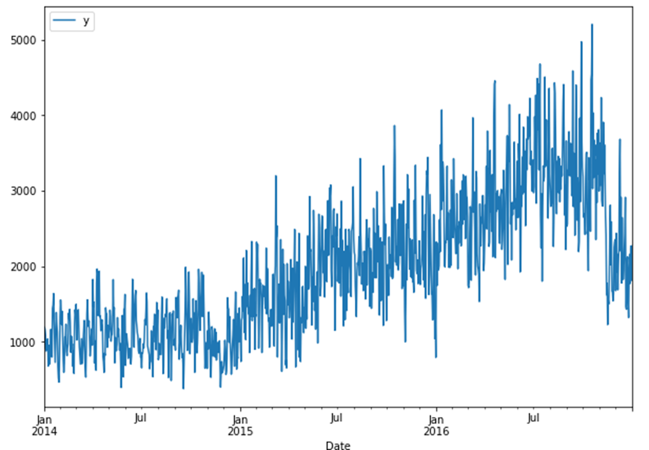
Pre-processing
Time series data must be smoothed out in a process called decomposition
This extracts three critical aspects of the data
Trend
Seasonality
Noise

Slide 8
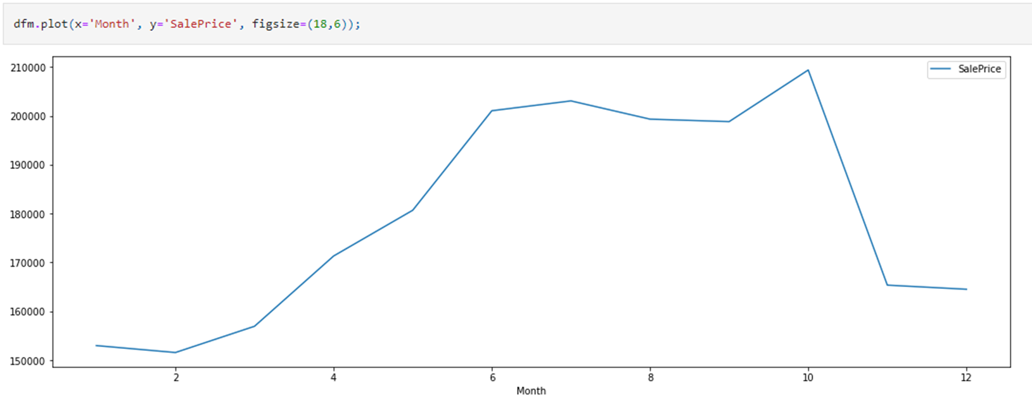
Seasonality
There appears to be seasonality in this data set
Would not use Arima model
Would begin with Sarimax and FBProphet

Slide 9
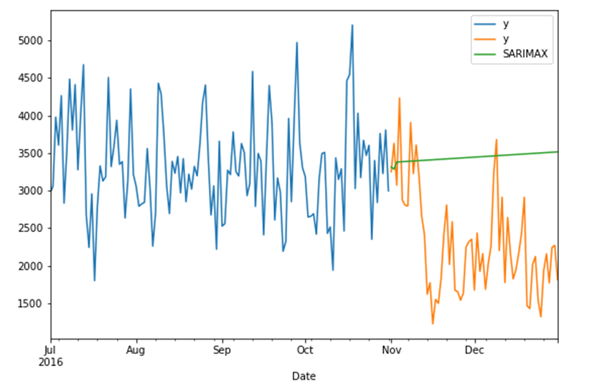
Machine Learning Models
Sarimax Model
Began with Sarimax model
Problem
Model could not account for drop in sales which occurred in test data

Slide 10
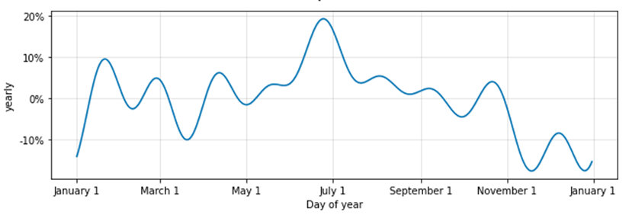
FBProphet
FBProphet
Had much better understanding of the yearly trend
Had much lower Mean Absolute Error
Was the model chosen for predictions

Slide 11
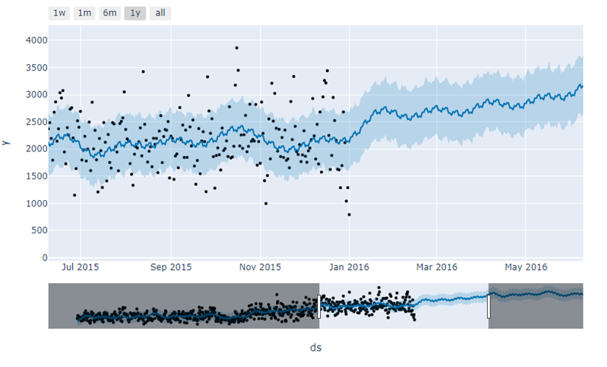
Prediction
Using FBProphet shows a general upward trend over next two quarters
Recommended to increase inventory levels over previous year

Slide 12

Future Improvements
Change univariate time series forecast to multivariate by adding holidays
See how shoe models affect sales

